Slide 1


Central processing unit
Shiryaeva Yulia
Zavaruev Ivan
PI19-1V

Slide 2





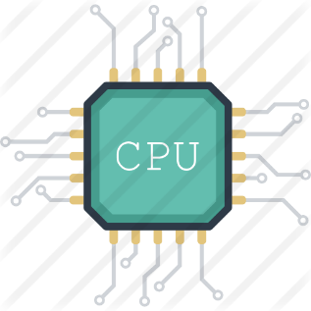
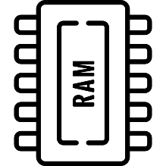


WHAT IS INSIDE PC SYSTEM?
INPUT
converts physical input
to binary information
MEMORY
stores information
CPU
calculates information
OUTPUT
converts information to physical output

Slide 3
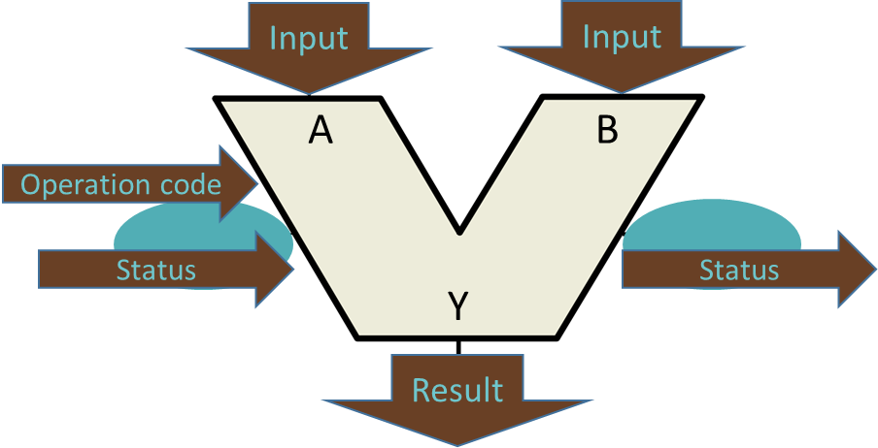
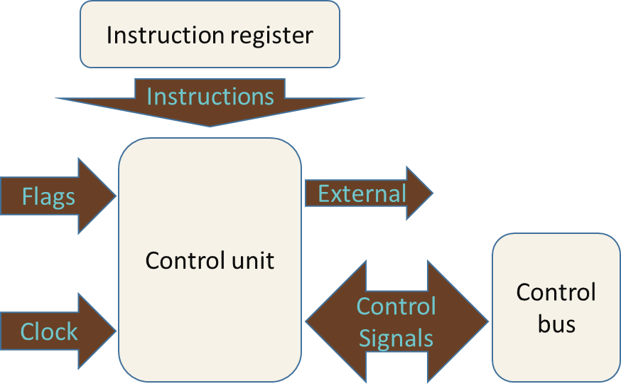
WHAT IS INSIDE CPU?
Arithmetic - Logic Unit
Control
Unit

Slide 4

WHAT IS ALU?
Arithmetic Logic Unit
Input
Input
A
B
Operation code
Status
Status
Y
Result

Slide 5
WHAT IS CONTROL UNIT?
Control Unit
Instruction register
Instructions
Control unit
Flags
External
Control
bus
Control Signals
Clock

Slide 6
THANKS FOR YOUR ATTENTION!

